Slide 1
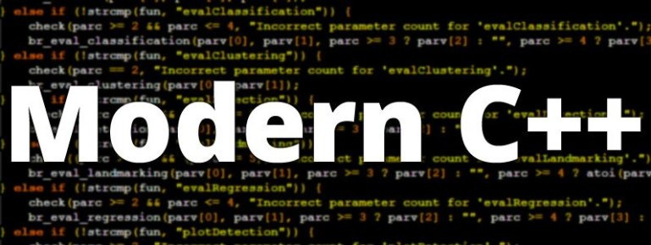
ADVAnce C++

Slide 2
MODERN C++
Categories Of Member Functions In Vector
Various Ways Of Iterating Over A Vector
Accessing A Vector
Sizing/Resizing A Vector
Manipulating A Vector

Slide 3
Categories Of Member functions of vector
The member functions of vector are basically divided into 4 categories.
These categories represent the type of operations these functions can perform and they are :
Iteration
Accessors
Capacity
Modifiers

Slide 4
Iterator functions
Member Function | Description
begin() | Returns an iterator pointing to the beginning element of the vector.
end() | Returns an iterator pointing to the general element that follows the end element of the vector.
rbegin() | Returns a reverse iterator pointing to the end element in the vector
rend() | Returns a reverse iterator pointing to the general element preceding the first element in the vector

Slide 5
Iterator functions
Member Function | Description
cbegin() | Returns a constant iterator to the beginning element of the vector.
cend() | Returns a constant iterator pointing to the general element that follows the end element of the vector.
crbegin() | Returns a constant reverse iterator pointing to the end element in the vector
crend() | Returns a constant reverse iterator pointing to the general element preceding the first element in the vector.

Slide 6
Forward & backward iterating
OUTPUT:
Forward Iteration: 10 20 30 40 50
Backward Iteration: 50 40 30 20 10
#include <iostream>
#include <vector>
using namespace std;
int main()
{
vector <int> v{10,20,30,40,50};
cout<<"Forward iteration: ";
for (auto i = v.begin(); i != v.end(); ++i)
cout<< *i << "\t";
cout<<endl<<"Backward iteration: ";
for (auto j = v.rbegin(); j != v.rend(); ++j)
cout << *j << "\t";
return 0;
}

Slide 7
Constant iterator
OUTPUT:
Forward Iteration: 10 20 30 40 50
Backward Iteration: 50 40 30 20 10
#include <iostream>
#include <vector>
using namespace std;
int main()
{
vector <int> v{10,20,30,40,50};
cout<<"Forward iteration: ";
for (auto i = v.cbegin(); i != v.cend(); ++i)
cout<< *i << "\t";
cout<<endl<<"Backward iteration: ";
for (auto j = v.crbegin(); j != v.crend(); ++j)
cout << *j << "\t";
return 0;
}

Slide 8
Manipulating using iterator
OUTPUT:
Iterating and manipulating: 10 20 30 40 50
Iterating again: 11 21 31 41 51
#include <iostream>
#include <vector>
using namespace std;
int main()
{
vector <int> v{10,20,30,40,50};
cout<<"Iterating and manipulating: ";
for (auto i = v.begin(); i != v.end(); ++i)
cout<<(*i)++<<"\t";
cout<<endl<<"Iterating again: ";
for (auto i = v.begin(); i != v.end(); ++i)
cout<<*i<<"\t";
return 0;
}

Slide 9
Manipulating while reverse iterating
OUTPUT:
Reverse Iterating and manipulating: 50 40 30 20 10
Reverse Iterating again: 51 41 31 21 11
#include <iostream>
#include <vector>
using namespace std;
int main()
{
vector <int> v{10,20,30,40,50};
cout<<"Reverse Iterating and manipulating: ";
for (auto i = v.rbegin(); i != v.rend(); ++i)
cout<<(*i)++<<"\t";
cout<<endl<<"Reverse Iterating again: ";
for (auto i = v.rbegin(); i != v.rend(); ++i)
cout<<*i<<"\t";
return 0;
}

Slide 10
Manipulating using constant iterator
#include <iostream>
#include <vector>
using namespace std;
int main()
{
vector <int> v{10,20,30,40,50};
cout<<"Constant Iterating and manipulating: ";
for (auto i = v.cbegin(); i != v.cend(); ++i)
cout<<(*i)++<<"\t";
cout<<endl<<"Iterating again: ";
for (auto i = v.cbegin(); i != v.cend(); ++i)
cout<<*i<<"\t";
return 0;
}
OUTPUT:
Error: increment of read only location

Slide 11
Manipulating using reverse constant iterator
#include <iostream>
#include <vector>
using namespace std;
int main()
{
vector <int> v{10,20,30,40,50};
cout<<"Constant Reverse Iterating and manipulating: ";
for (auto i = v.crbegin(); i != v.crend(); ++i)
cout<<(*i)++<<"\t"; // will give error
cout<<endl<<"Reverse Iterating again: ";
for (auto i = v.crbegin(); i != v.crend(); ++i)
cout<<*i<<"\t";
return 0;
}
OUTPUT:
Error: increment of read only location

Slide 12
Accessor functions
Member Function | Description
front() | Returns the first element of the vector
back() | Returns the last element of the vector
data() | Returns the pointer to the array implemented internally by vector.
at(i) | Accesses the element stored at index ’i’.
[i] | Accesses the element stored at index ’i’.

Slide 13
Accessing a vector
#include <iostream>
#include <vector>
using namespace std;
int main()
{
vector <int> v{10,20,30,40,50};
cout<<endl<<"Using the subscript operator v[3]:" << v[3];
cout<<endl<<"Using the at(n) function : at(3) = " << v.at(3);
cout<<endl<<"Using the front() function : front() = " << v.front();
cout<<endl<<"Using the back() function: back() = " << v.back();
int* p = v.data(); // Pointer to the first element
cout<<endl<<"The first element of the vector is " << *p<<endl;
return 0;
}
OUTPUT:
Using the subscript operator v[3] : 40
Using the at(n) function : at(3)=40
Using the front() function : front()=10
Using the back() function : back()=50
The first element of vector is 10

Slide 14
Accessing a vector
OUTPUT:
vector contains: 10 20 0 100 0
#include <iostream>
#include <iostream>
#include <vector>
int main ()
{
vector<int> v (5);
int* p = v.data();
*p = 10;
++p;
*p = 20;
p[2] = 100;
cout << "vector contains:";
for (int i=0; i<v.size(); ++i)
cout << ' ' << v[i];
return 0;
}

Slide 15
capacity functions
Member Function | Description
size() | This function is used to find out the number of elements in the vector.
max_size() | This function gives the maximum number of elements a vector can store.
capacity() | It gives the current storage space of the vector.
resize(n) | This function resizes the vector to the mentioned size.
empty() | This function is used to find out if the vector is empty.

Slide 16
capacity functions
Member Function | Description
shrink_to_fit() | This function reduces the vector to reduce its capacity and clears the elements that are beyond it.
reserve() | This function makes the vector capacity to hold a specified number of elements.

Slide 17
Size V/s Capacity
#include <iostream>
#include <vector>
using namespace std;
int main()
{
vector <int> v;
cout<<"Total space for v="<<sizeof(v)<<endl;
cout<<"size="<<v.size()<<",capacity="<<v.capacity()<<endl;
int x=10;
for(int i=1;i<=10;i++,x=x+10)
{
v.push_back(x);
cout<<"============================================"<<endl;
cout<<"After inserting "<<i<<" ele"<<endl;
cout<<"Total space for v="<<sizeof(v)<<endl;
cout<<"size="<<v.size()<<",capacity="<<v.capacity()<<endl;
}
return 0;
}

Slide 18
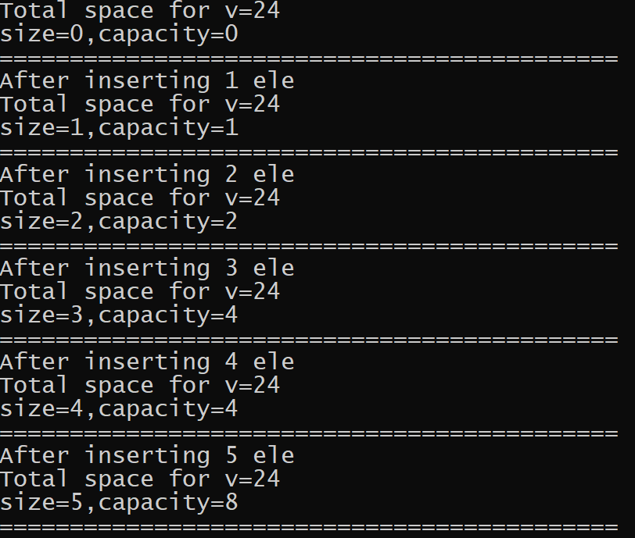
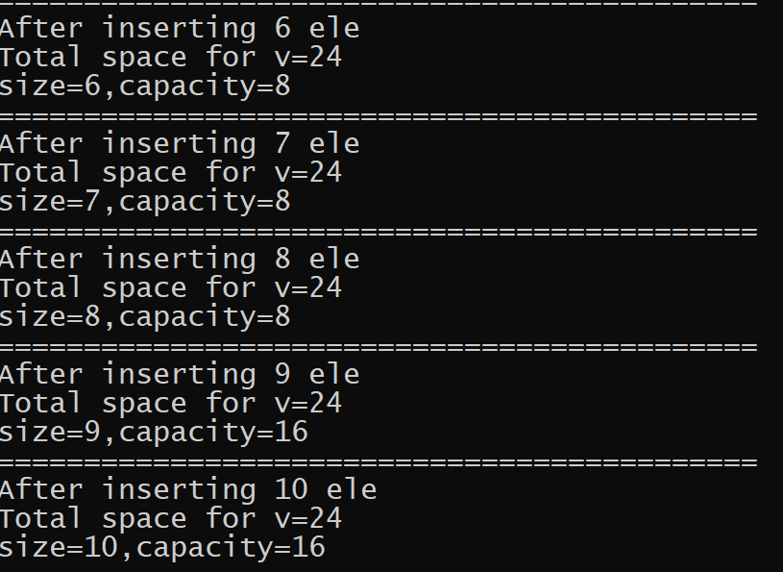
output

